Slide 1





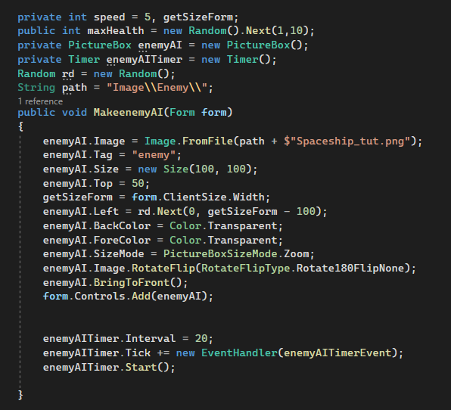









G2
Search...
Admin
Coding Implementation
4. Build Controls Character & Enemy & Bullet
Enemy initialization.
To initialize the enemy, we create an additional class called Enemy.cs .
To create the enemies, we used a PictureBox to create, and added a Timer to handle auto-move for the enemy.
And here is how we execute the code in the Enemy class.

Slide 2
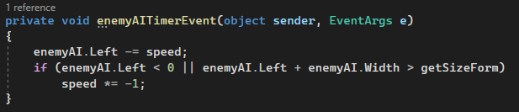
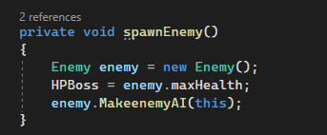
G2
Search...
Admin
Coding Implementation
4. Build Controls Character & Enemy & Bullet
We handle Enemy's migration automatically through the Timer as follows:

Slide 3
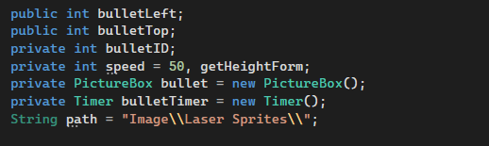
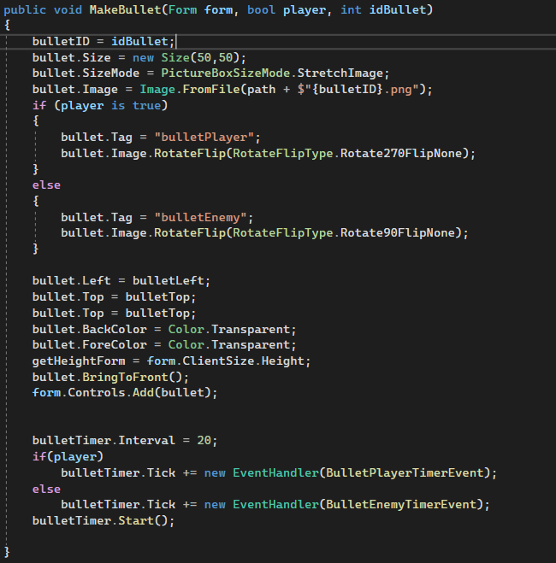
G2
Search...
Admin
Coding Implementation
4. Build Controls Character & Enemy & Bullet
Bullet initialization.
Next we create projectiles that shoot out, we have 2 targets to fire bullets, the first is for the player, the second is the Enemy. In addition, we also have to determine the type of ammo that the player uses so we need references to the Form, bool Player and Bullet ID.
Here's how we execute the code:

Slide 4
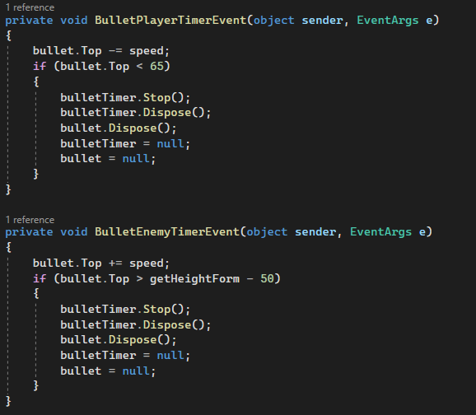
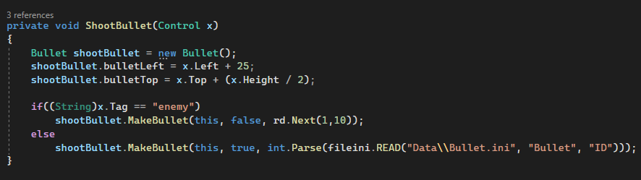
G2
Search...
Admin
Coding Implementation
4. Build Controls Character & Enemy & Bullet
We have 2 use cases of Timer, the first is for the character, the second is for the Enemy. For the character we adjust the bullet will shoot from bottom to top, and for Enemy, it will be from top to bottom.
For us to use in the game interface, we call the Enemy class with the following method:

Slide 5
G2
Search...
Admin
Coding Implementation
5. Handling Game Situations.
Characters Shooting Enemy.
We handle the control for the character, create the enemy, discharge the bullets, then we proceed to handle the situation where the character discharges bullets at the enemy.
To distinguish players from enemies, we use Tag Objects to differentiate.
We will then check the impact agent for each object.

Slide 6
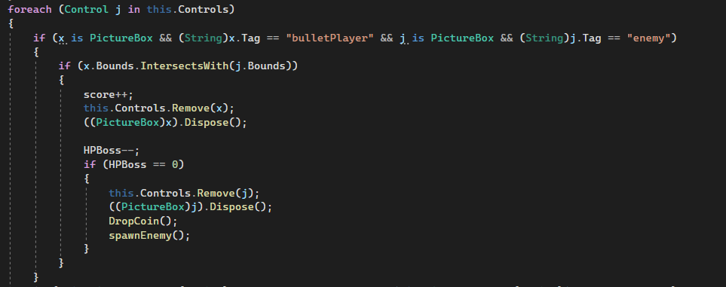
G2
Search...
Admin
Coding Implementation
5. Handling Game Situations.
Here's how we execute the code:

Slide 7
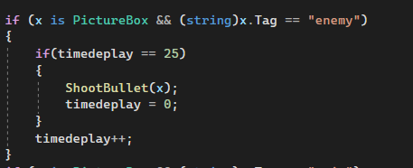
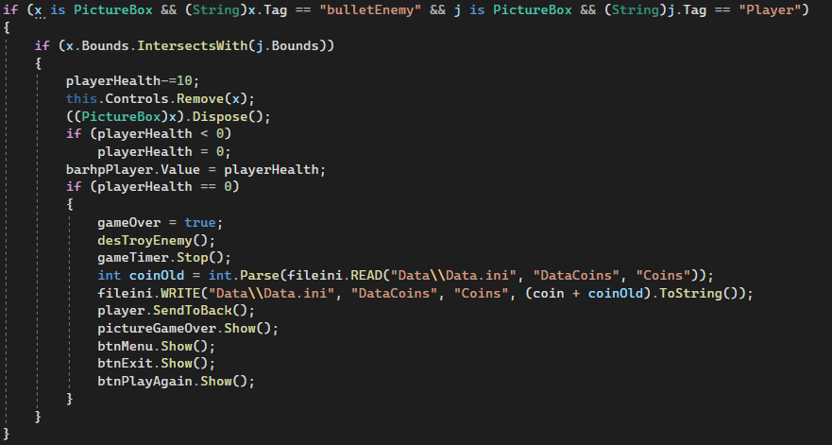
G2
Search...
Admin
Coding Implementation
5. Handling Game Situations.
Enemy Shooting Characters & End Game.
Similar to the Character Shooting the enemy above, the code implementation is the same. And by the way we have added end game function here, when player is hit with all health it will make game over here and will show end game result along with other buttons.

Slide 8
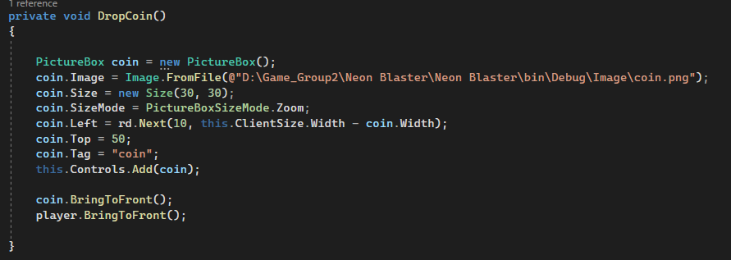
G2
Search...
Admin
Coding Implementation
5. Handling Game Situations.
Drop Coins.
As in the above code, we have added the function DropCoins(), this is a function that will drop coins when an enemy dies, this coin is used for players to buy items, at the end of the game you will see a paragraph code to save coin to data.
Creating a coin is quite simple, just create a PictureBox and Add it to the form.

Slide 9
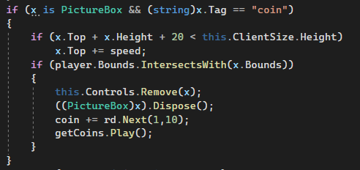
G2
Search...
Admin
Coding Implementation
5. Handling Game Situations.
Then we use a Stopwatch to make it fall from the top, players just need to touch the coin to have it added to their data

Slide 10
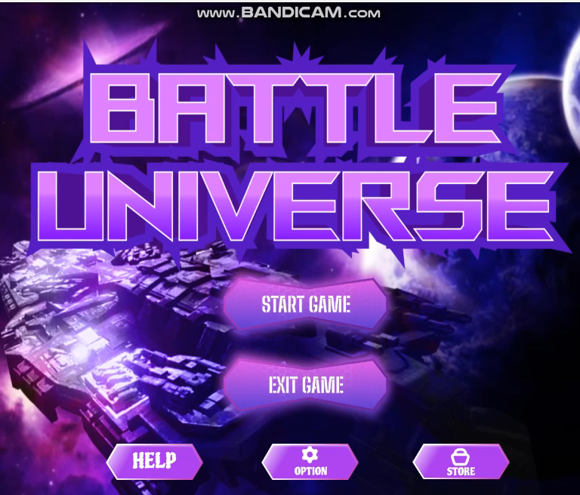
G2
Search...
Admin
STORE

Slide 11
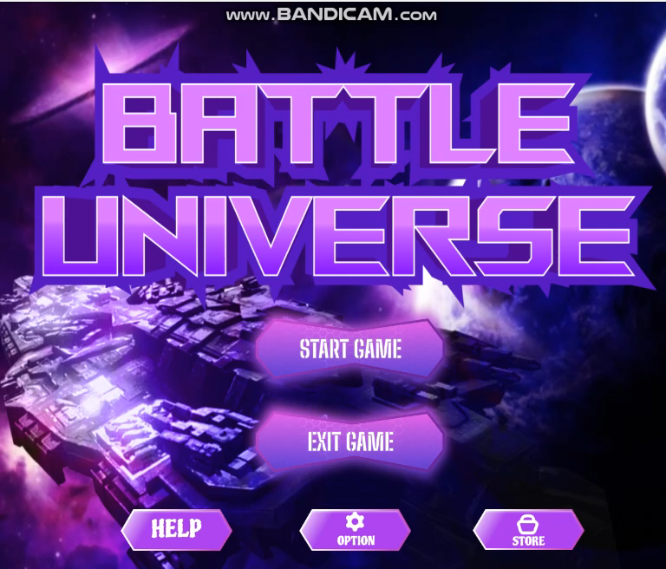
G2
Search...
Admin
OPTION

Slide 12

G2
Search...
Admin
PLAY

Slide 13

See you again
Thank You
LOG OUT
Group 2

